Slide 1

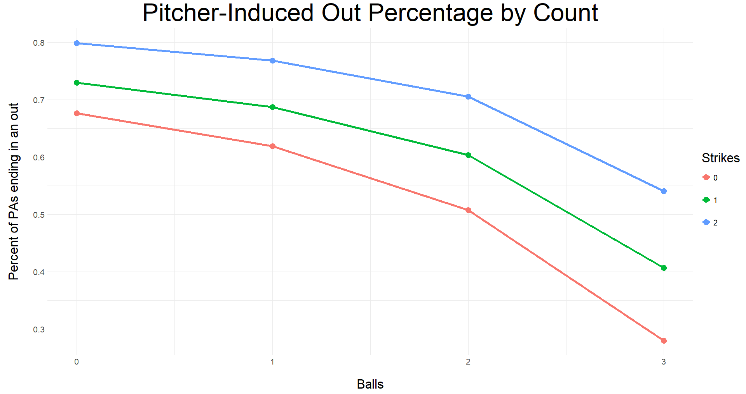
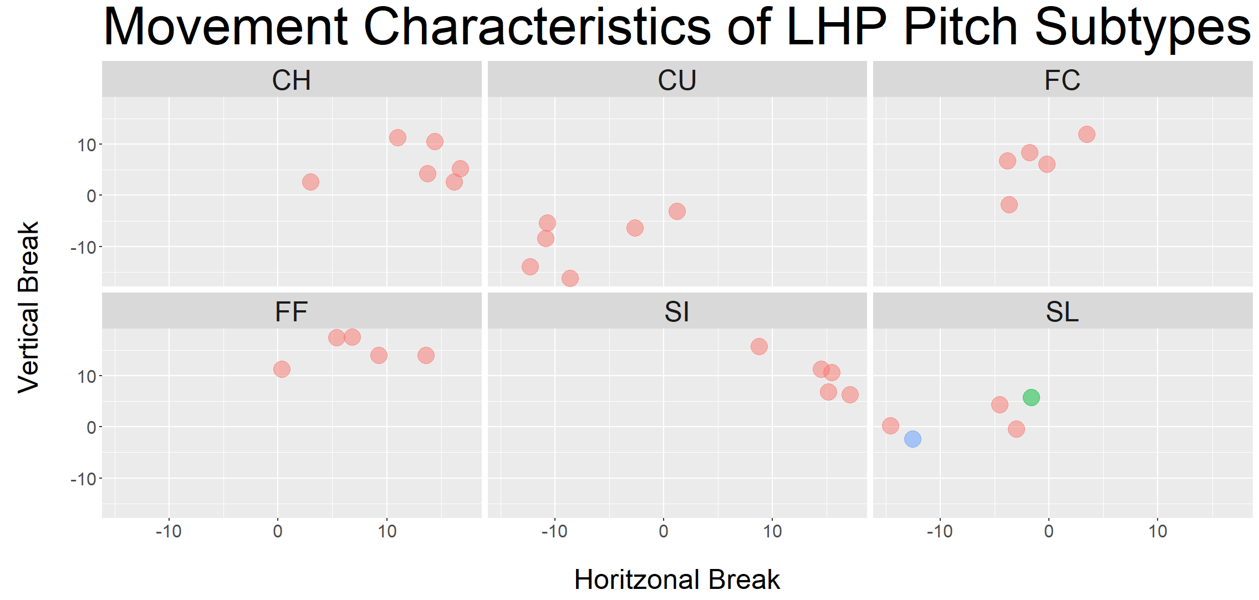
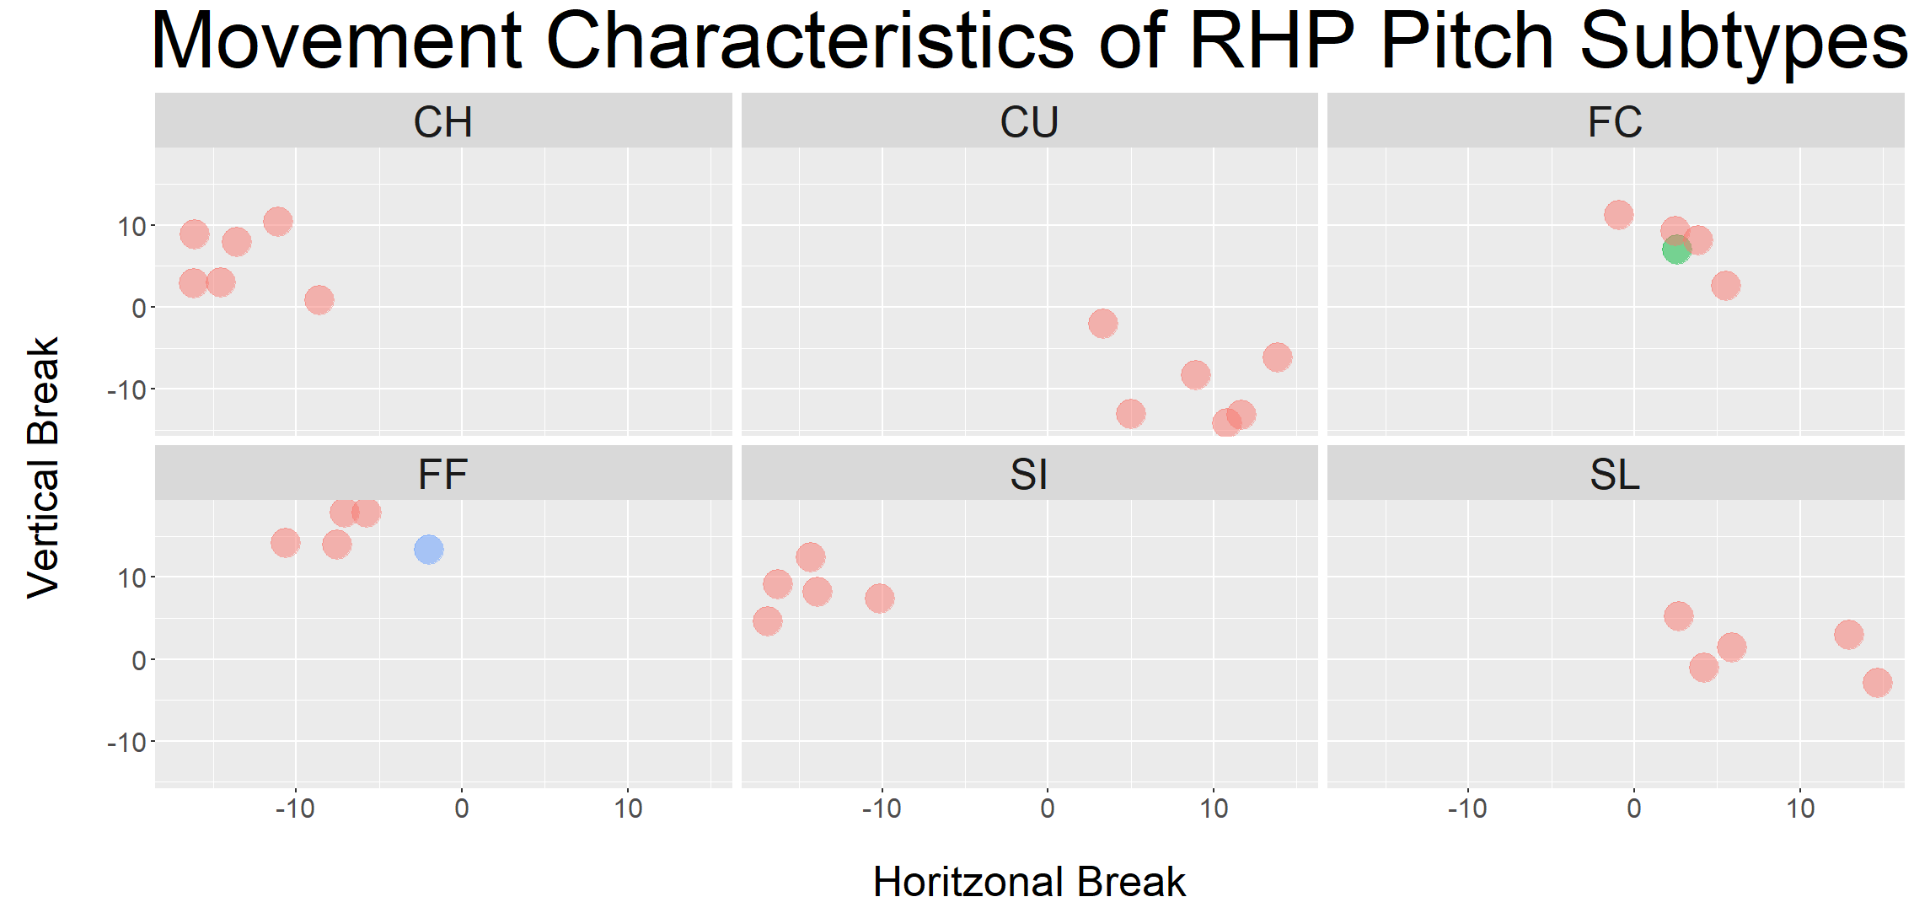
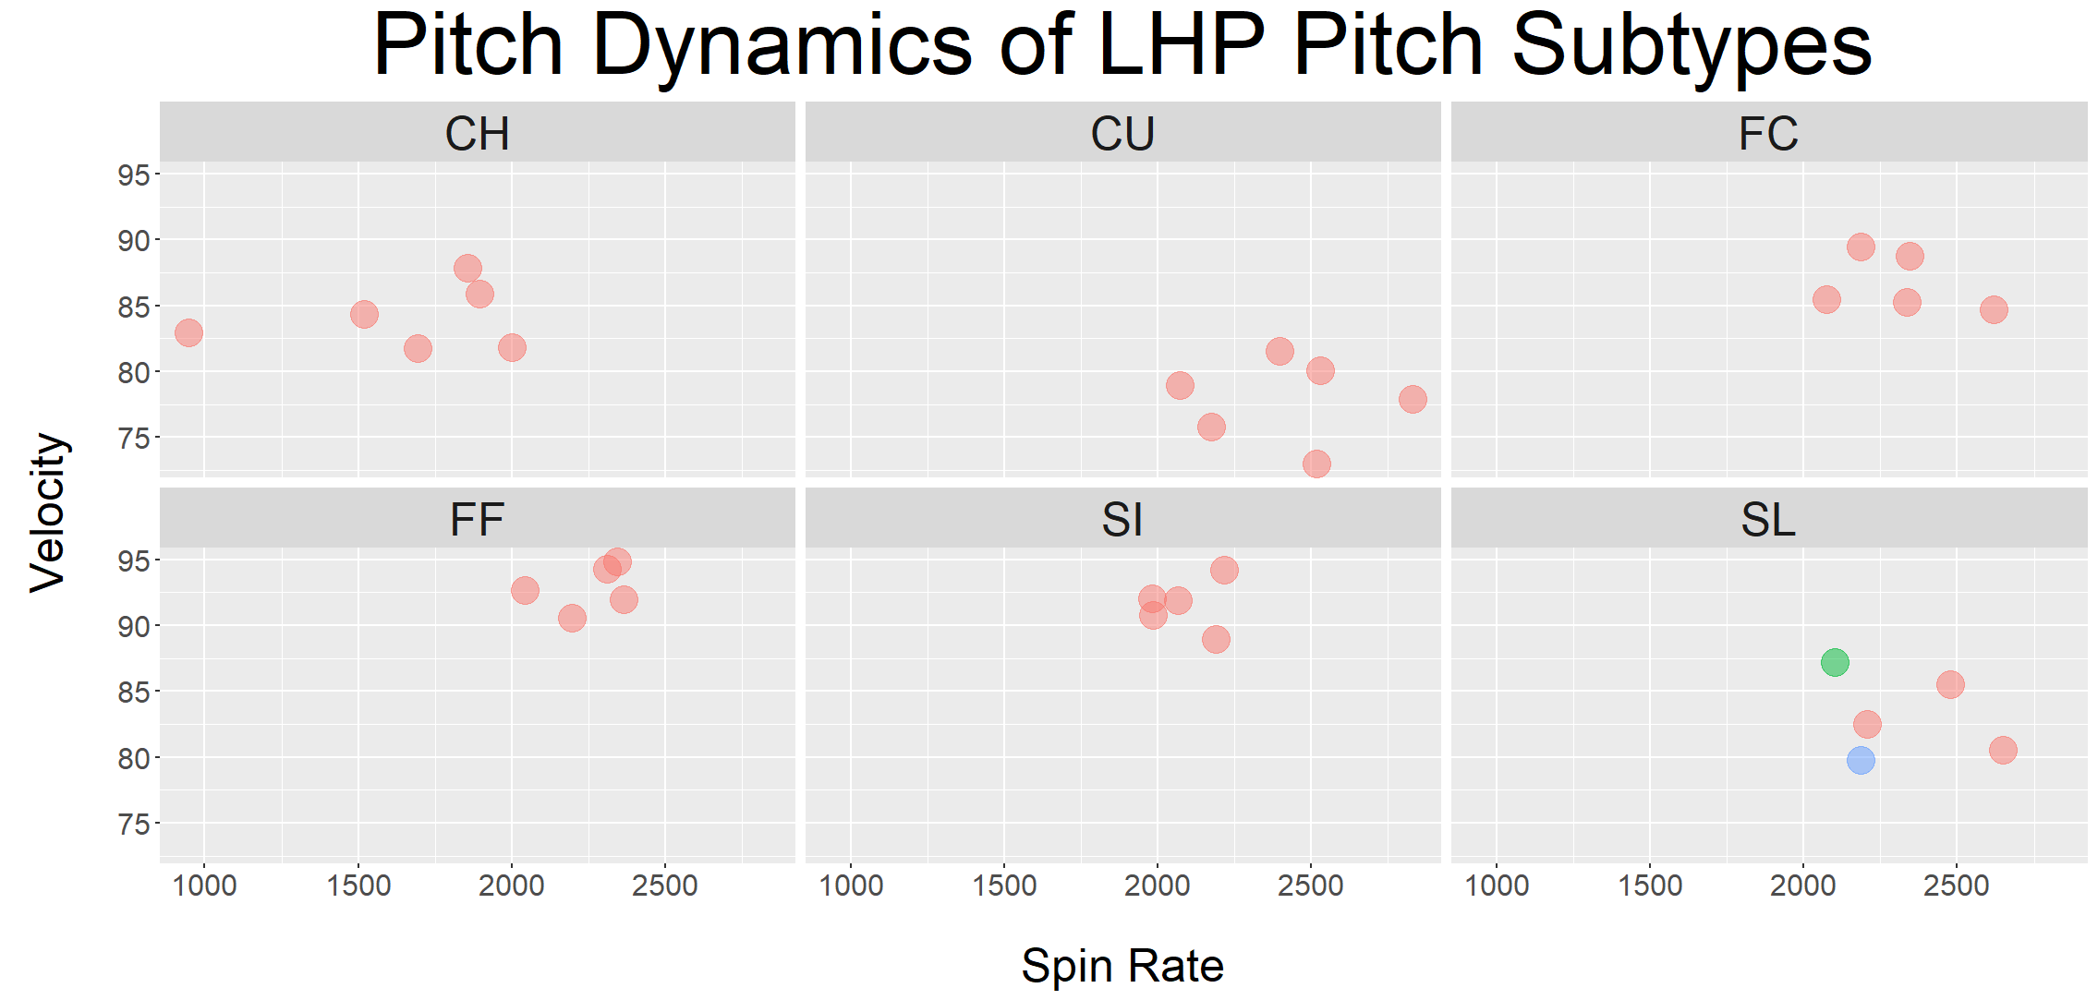
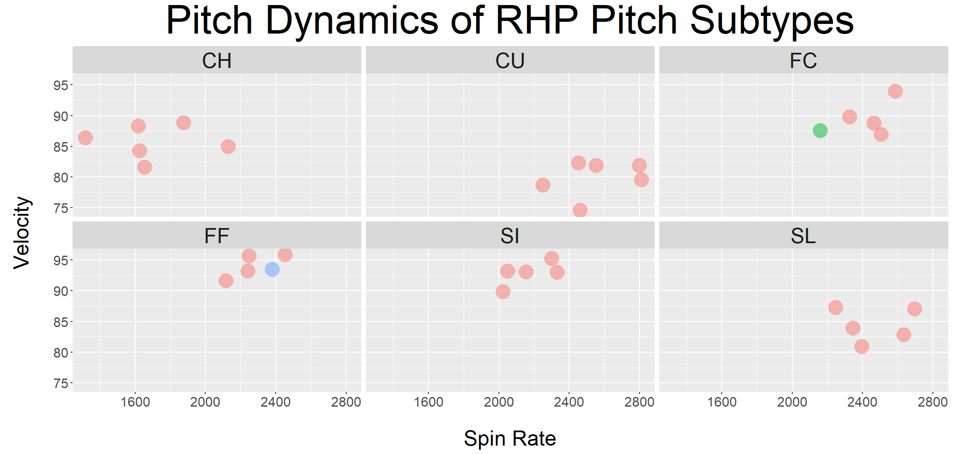
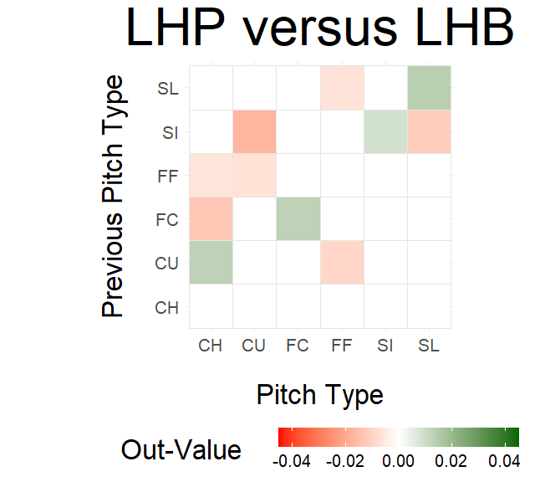
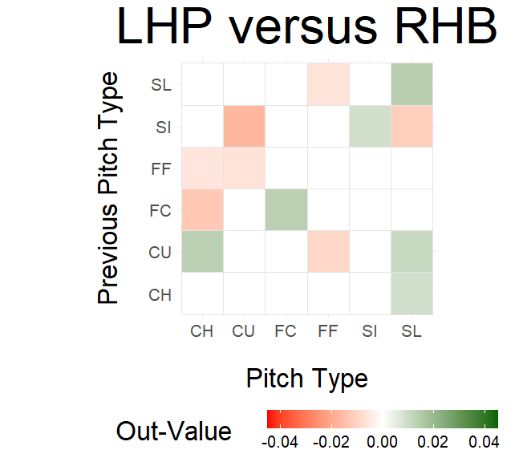
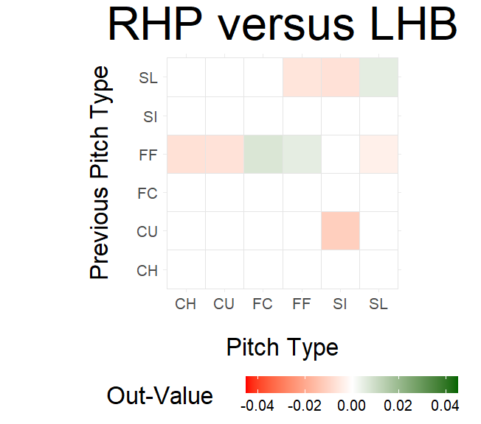
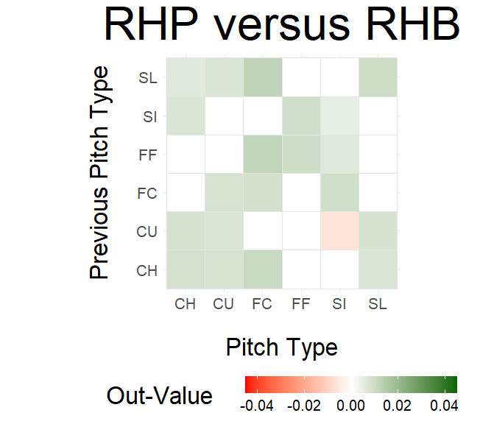
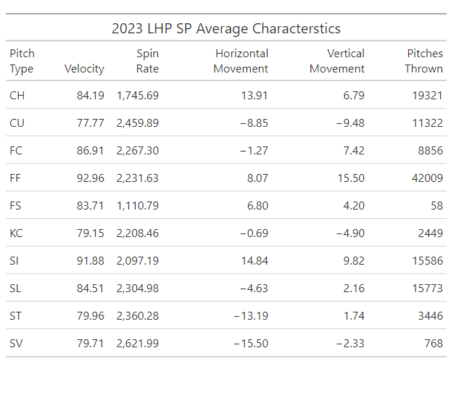
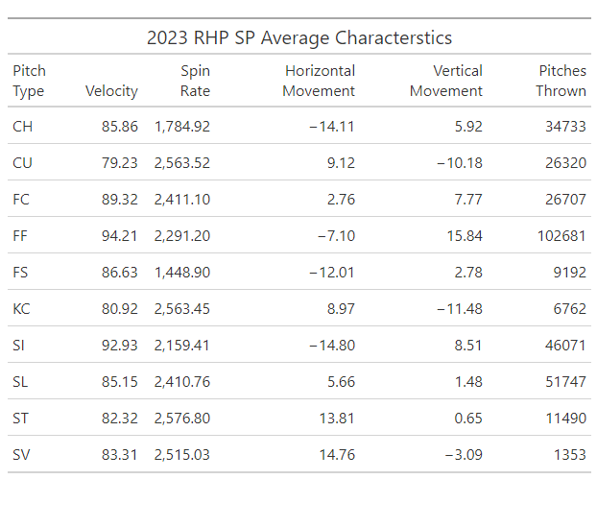
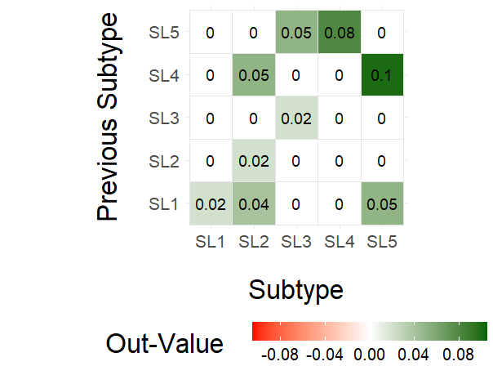
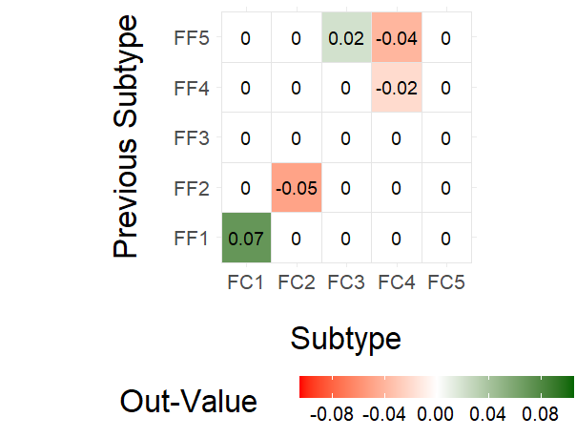
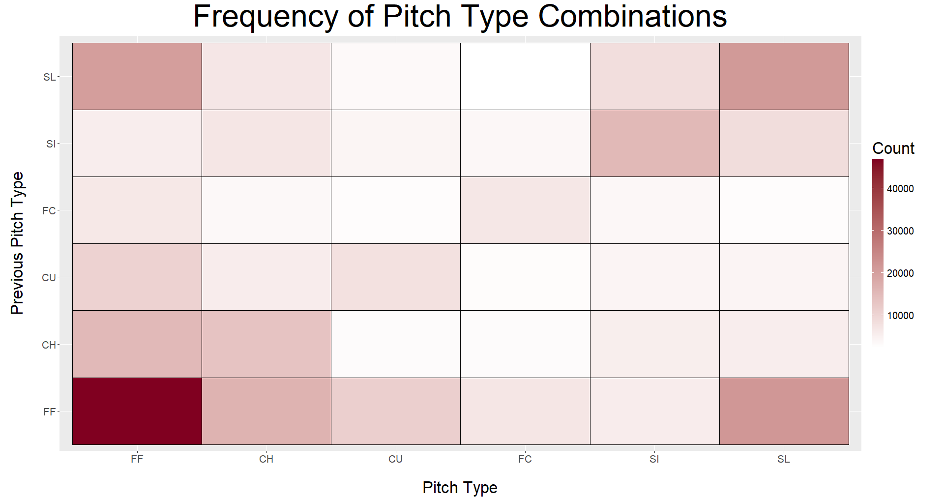
Optimal Pitch Subtype Permutations for MLB Starting Pitchers
Sebastian Kirkpatrick Gregory J. Matthews Mena CR. Whalen
Loyola University Chicago
Background
Methods
Clustering
One facet of pitching strategy in Major League Baseball is to deceive hitter by varying the type of pitches thrown. We are interested in the best sequences of these pitch types. MLB collects the data of each pitch using Statcast, including physical characteristics (e.g. release speed, spin rate, vertical/horizontal movement) and pitch type.
Previous work [1] has shown that there are subtypes found within each observed pitch types that are not recorded by Statcast. Using the physical characteristics of the pitches, we employed clustering to identify these subtypes.
With the subtype classification, we explored the effectives of different subtypes sequences during the 2023 season.
Statcast data can be accessed via the baseballr package, which can be found at https://billpetti.github.io/baseballr/.
We evaluated the performance of a pitch on the change in out probability. That value is calculated from a 3-year rolling average of out probability based on the state of the count.
Model 1: Mixed effects model predicting out-value as a function of pitch type and previous pitch type, controlling for the game state with fixed effects and random effects for pitcher, batter, and park.
Model 2: Same as Model 1, but using subtype instead of primary type.
Model 1 was estimated using all of the pitching data. We then found the most effective primary pitch type combinations. For those combinations we built Model 2 using the subset of the pitches were those combination occurred.
The above graphs plot the centroids of the subtype clusters, which were identified by K-Means. The number of clusters were validated by minimizing within-cluster-sum-of-squares while also considering parsimony.
6 subtypes were observed for Changeup and Curveball, while the other 4 primary types each had 5 subtypes, resulting in 32 total subtypes for both pitcher handedness.
The color dots represent the pairings we found to be most effective. Blue is the setup and green is the pitch thrown.
Results
EDA
Discussion & Future Work
Model 1 picks up on a platoon advantage for RHP, but outputs similar out-values for LHP regardless of batter handedness. Based on our results, the most effective RHP primary type combination was a fastball setting up a cutter. For LHP, it was a slider setting up a slider.
How could this help a player/team?
In-game sequencing decisions
Improved pitch design
Consider different inputs for the clustering algorithm
Pitch performance alternatives to out-value
Do changes in distribution of sequencing affect success?
Due to low sample sizes of specific pitch types, we combined low-count types into broader types. Knuckle-Curve (KC) was added to Curveball, Splitter (FS) to Changeup, and Sweeper (ST) and Slurve (SL) to Slider, creating 6 primary types: Changeup (CH), Curveball (CU), Cutter (FC), Four-Seam (FF), Sinker (SI), and Slider (SL).
References
[1] Dvorocsik, G., Sarris, E., & Camp, J. (2020). Using Clustering to Find Pitch Subtypes and Effective Pairings. Baseball Research Journal, Spring 2020.
[2] Johnson, R., Wichern D. (2002). Applied Multivariate Statistical Analysis.
[3] Everitt, B., Horton T. (2011). An Introduction to Applied Multivariate Analysis with R.
For RHP, the best combination was Four-Seam 1 setting up Cutter 3. In 2023, Jack Flaherty threw that combination the most. For LHP, the best combination was two different sliders: Slider 4 setting up Slider 5. The primary user of that combination in 2023 was Sean Manaea. While both of those guys had poor 2023 seasons, their 2024 seasons have been much more favorable.

